Slide 1
Low Fidelity Prototyping
CompSci 345 / SoftEng 350
Kreshnik Pireva

Slide 2
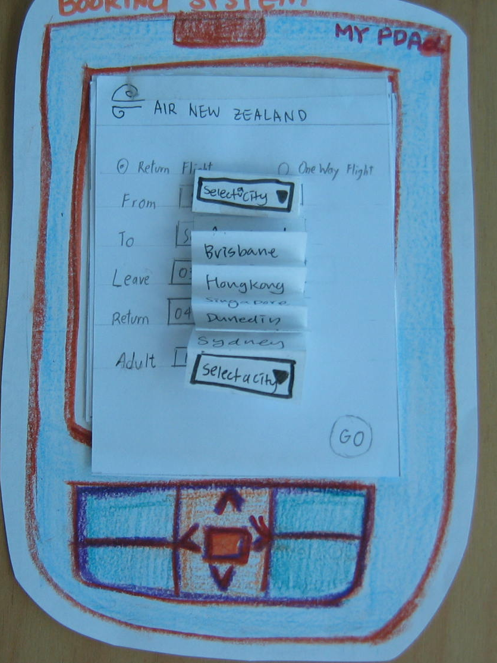
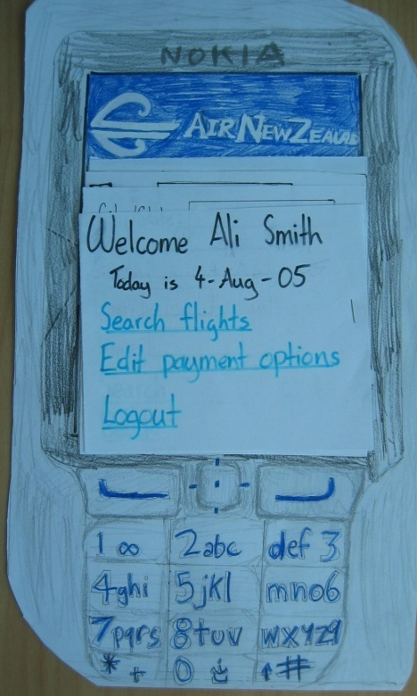
How to make a low-fi prototype
Pen, paper, coloured pencils, scissors, cellotape …..
  Just like primary school ☺
  Phone interface for airline booking

Slide 3
How to make a low-fi prototype
Wizard of Oz/Cognitive walkthrough with paper prototype
  https://www.youtube.com/watch?v=GrV2SZuRPv0

Slide 4
Why Prototype
Experiment with alternatives
Quick feedback
Fix ‘interface’ problems early on
Saves money
Low Fidelity – Quick diagrams showing basic layout and flow
High Fidelity – Looks and works more like final product but with reduced functionality

Slide 5
Plan for Today
Make a low-fi prototype (in groups of 4)
Keeping constraints in view
Share and critique our solutions

Slide 6
Problem Statement
Customer is a fast-food restaurant, facing following problems while getting orders:
  Verbal communication is prone to errors (especially in busy hours)
  Language barriers
  Customized orders have to be memorized and are often miscommunicated
Wants to automate “ordering”
Adapted From: School of Information Management and Systems, University of California, Berkley

Slide 7
Requirements
Accommodate users with no training
Speed in placing order is extremely important
System should help in swift order processing and delivery
The visual appeal of the food menu is also very important!

